Slide 1

Microsoft Azure
API Management

Slide 2



Hello!
Thank you for joining us today
Speaker: Luke Murray
Microsoft Learn Expert and Microsoft Azure MVP, and Senior Consultant from Hamilton, New Zealand.
https://x.com/lukemurraynz
https://www.linkedin.com/in/ljmurray/
https://luke.geek.nz/

Slide 3
Azure API Management overview
In-depth look at the API life cycle phases
Design
Develop
Secure
Publish
Scale
Monitor
Analyze

Slide 4
Digital transformations runs on APIs
Connected experiences
APIs
Services and data

Slide 5

API governance and usage defines success
Façade Abstraction
Aggregate or slice Normalize or modernize Decouple life cycle Mock
Front door Control
Route and accelerate Secure and protect Transform Observe
Frictionless consumption Onboarding
Discover and learn Try Obtain access Get started

Slide 6
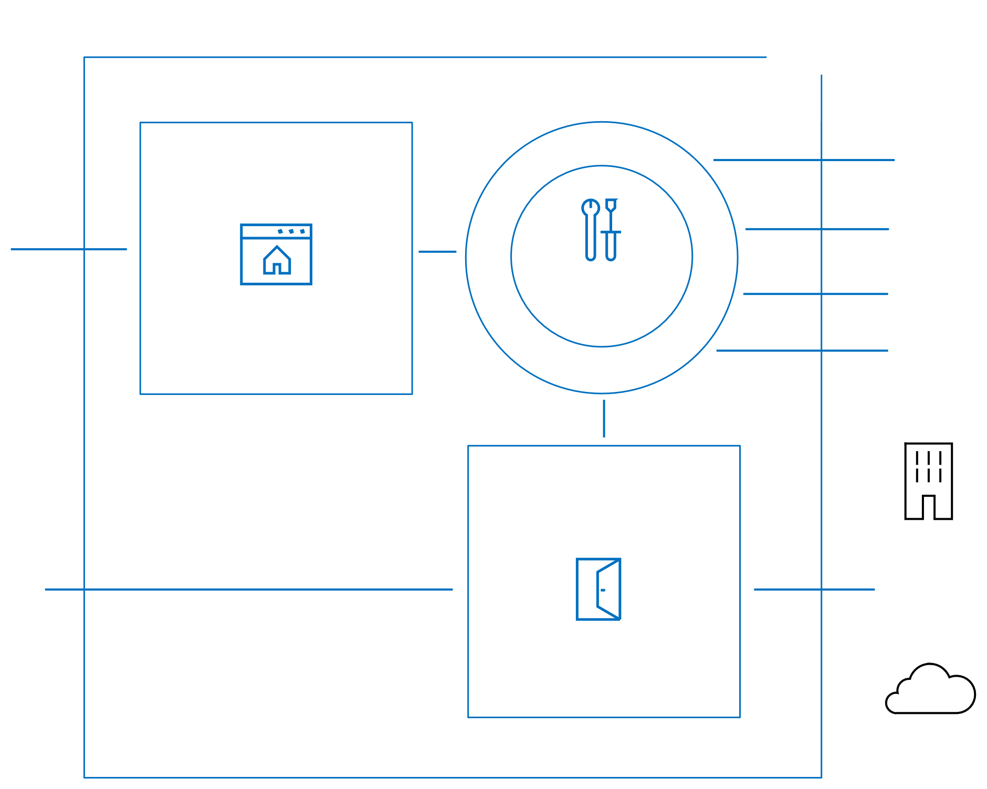










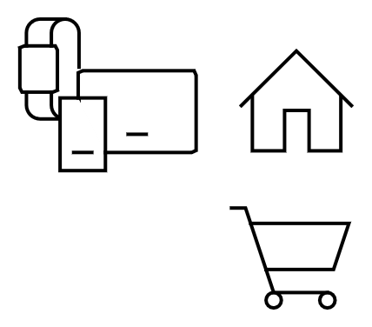
















Azure API Management
Developer portal
API
Discover Learn Try
Onboard
Get help
Abstract Secure Evolve Observe Monetize
App developers
Management
API providers
plane
User plane
Gateway
Employees Partners Customers
Data plane
Apps on devices
(micro)services

Slide 7
Fully-managed serverless and dedicated tiers
Consumption tier
No infrastructure to provision or manage
Developer | Basic | Standard | Premium tier
No infrastructure to provision or manage
Built-in auto-scaling down to zero
Manual scaling or external auto-scaling
Consumption-based micro billing
Billing based on reserved capacity
Variable, usage-based monthly cost
Constant, predictable monthly cost
No reserved capacity
Reserved capacity
Shared management plane
Dedicated management, user, and data planes
On-demand activation
Always on
Curated set of features and usage limits
Full set of features. Not governed.

Slide 8
Fully-managed serverless and dedicated tiers
Feature | Basic | Basic v2 | Standard | Standard v2 | Premium
Microsoft Entra Integration | No | Yes | Yes | Yes | Yes
Virtual Network (VNet) Support | No | No | No | Yes | Yes
Private Endpoint Support | Yes | No | Yes | No | Yes
Multi-region Deployment | No | No | No | No | Yes
Availability Zones | No | No | No | No | Yes
Autoscaling | Yes | No | Yes | No | Yes
Self-hosted Gateway | No | No | No | No | Yes
Backup and Restore | Yes | No | Yes | No | Yes
Management over Git | Yes | No | Yes | No | Yes
Static IP | Yes | No | Yes | No | Yes

Slide 9






































Azure Application platform
Application platform
API
Management
Web App
Function App
Logic App
ML App
Worker App
Integration
Events
App Developer
VS Code
GitHub
Application
Messaging
package
Azure Serverless
Azure Kubernetes Service
Management
Azure Resource Manager
Azure Arc
IT Pro
Azure Policy
Hosting
Azure
On-premises
IoT Edge
Multi-cloud

Slide 10



















Value proposition
"Accelerate your API strategy with Azure API Management, the comprehensive lifecycle solution trusted by thousands of enterprises worldwide. From abstraction and security to observability and discoverability, the APIM platform empowers you to manage APIs effortlessly across clouds and on-premises environments. Built for reliability, security, scalability, and performance, it's designed to support both DevOps and developers alike, seamlessly integrating with Azure services. Benefit from global availability, robust support, and competitive, accessible pricing—Azure API Management simplifies API management so you can focus on innovation."

Slide 11
Full API lifecycle
Design
Develop
Secure
Publish
Scale
Monitor
Analyze

Slide 12
Full API lifecycle
Design
Develop
Secure
Publish
Scale
Monitor
Analyze

Slide 13
API lifecycle: design
Code-and design-first approaches to building APIs
API Management supports both approaches to building APIs: Code-first approach
Implement the API and generate the API specification as an afterthought (i.e. with Swashbuckle) Benefits:
More convenient for API developers The only option for existing APIs
Design-first approach
Create an API specification, review it with stakeholders, and implement the API Kickstart development by scaffolding the code from the API specification Benefits:
Better API consumer experience thanks to the deliberate API design Reduced risk thanks to the API review processes

Slide 14
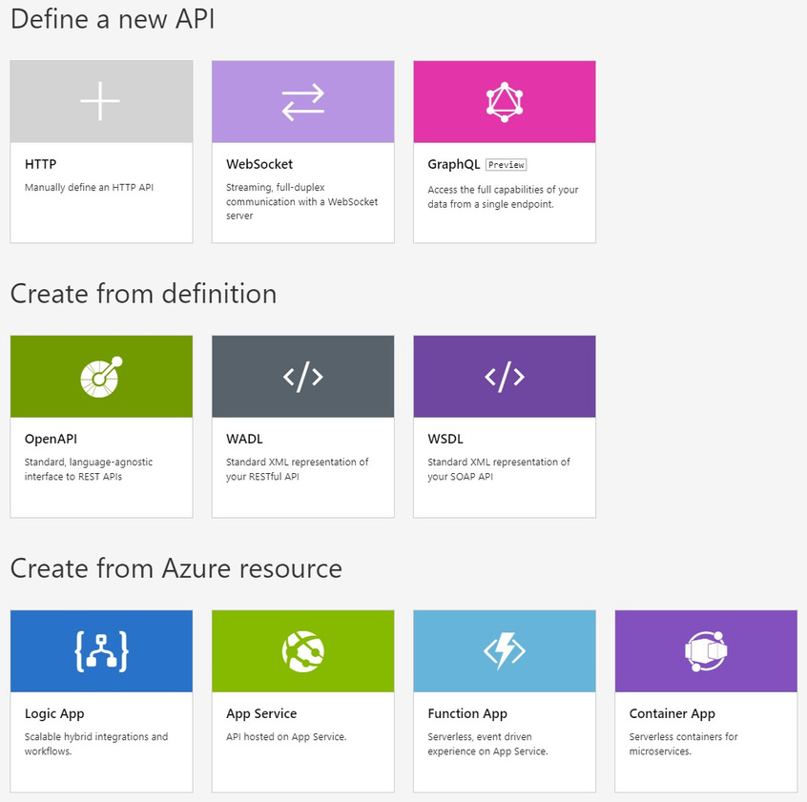
API lifecycle: design
Create an API
Support for SOAP, REST, WebSocket and GraphQLAPIs
Import an API from OpenAPI(1,
2, or 3), WADL, or WSDL files
Import an API from App Service,
Logic App, Function App, or
Container App
Create a blank API

Slide 15
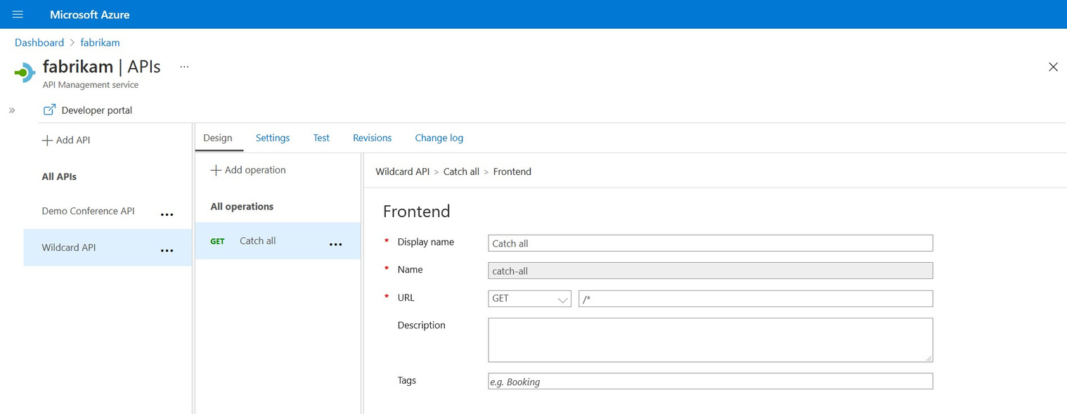
API lifecycle: design
Code-first approach –use the wildcard proxy mode
Wildcard “*” proxy mode
Use to route all requests through API Management if an accurate API specification doesn’t exist Use built-in API design features to improve the specification

Slide 16
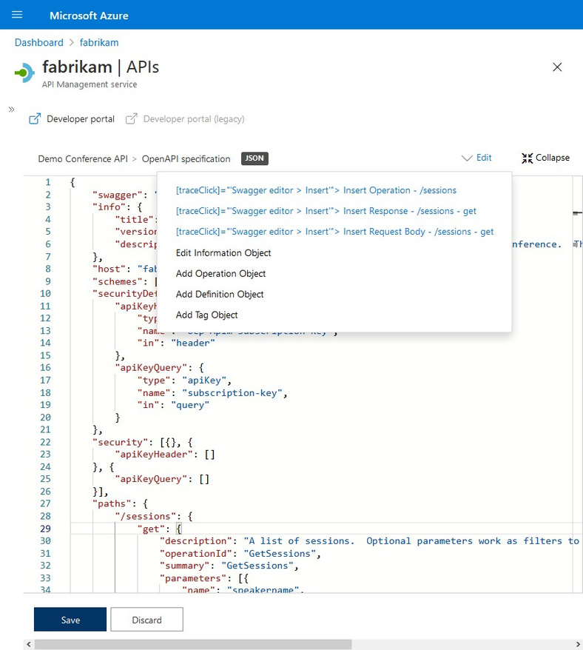
API lifecycle: design
Design the API
Define the API with form-based or text- based editors in the Azure portal or the Visual Studio Code extension
Test the API in the Azure portal and
generate schemas from the API responses

Slide 17
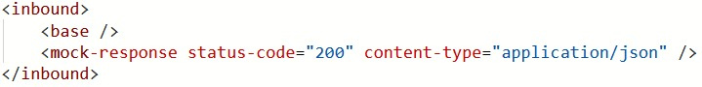

API lifecycle: design
Design-first approach –mock the API
Unblock front-end teams by mocking API responses Use an example defined in the API definition Configure with a single-line policy
API
200 OK
{
}
“message”: “example”

Slide 18
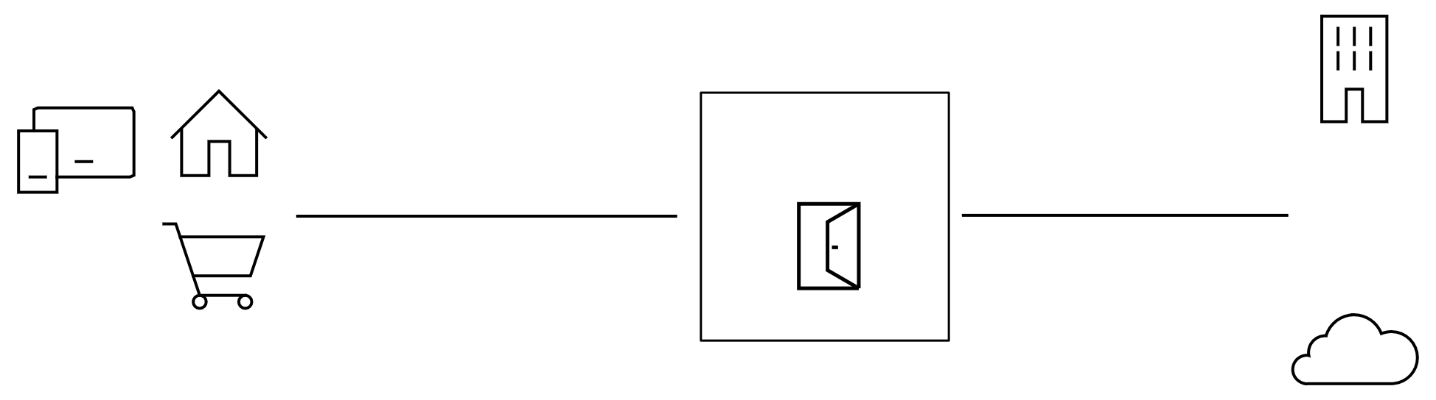

API lifecycle: design
WebSocketAPI support
Gateway
WebSocket
WebSocket
Passthrough support for WebSocket APIs
Client applications establish WebSocket connections with APIM API Management establishes WebSocket connections with backend services API Management proxies WebSocket messages
Features
CRUD WebSocket APIs Apply policies to handshake requests Browse WebSocket APIs in the Developer portal Test WebSocket APIs in the Azure and Developer portals Azure Monitor metrics and logs

Slide 19
DEMO

Slide 20
Full API lifecycle
Design
Develop
Secure
Publish
Scale
Monitor
Analyze

Slide 21

API management solves API-related challenges
Connected experiences
Consume
Mediate
Publish
Developer portal
Gateway
Azure portal
Developers
(use APIs)
APIs
Publishers
(provide APIs)
Services and data

Slide 22








API management solves API-related challenges
Connected experiences
Product 1
Product 2
Product 3
Product 4
Product 5
API Management
Backends on Azure
Backends on-premises
Services and data

Slide 23

API lifecycle: design
Connected experiences
Encapsulate common API management functions
Access control, Protection, Transformation, Caching, …
Mutate request context or change API behavior
Add a header or throttle for example
Set in the inbound and outbound directions
Applied at a variety of scopes or on error
Scope determines which APIs are affected
Can define custom scopes in addition to four available b default
Composed into a pipeline from effective scopes
Degree of control over inheritance of scopes, i.e. <base/> element
Don’t delete <base/> inadvertently
http://aka.ms/apimpolicyexamples

Slide 24
Policy scopes
Connected experiences
GET /foo/bar HTTP/1.1
Host: api.constoso.com
Key: 0123456789
CORS
LOG
global
workspace
0123456789
product
RATE
QUOTA
from caller
inbound
to backend
/foo
api
JWT
/bar
operation
CACHE
URL
BODY
to caller
from backend
outbound

Slide 25
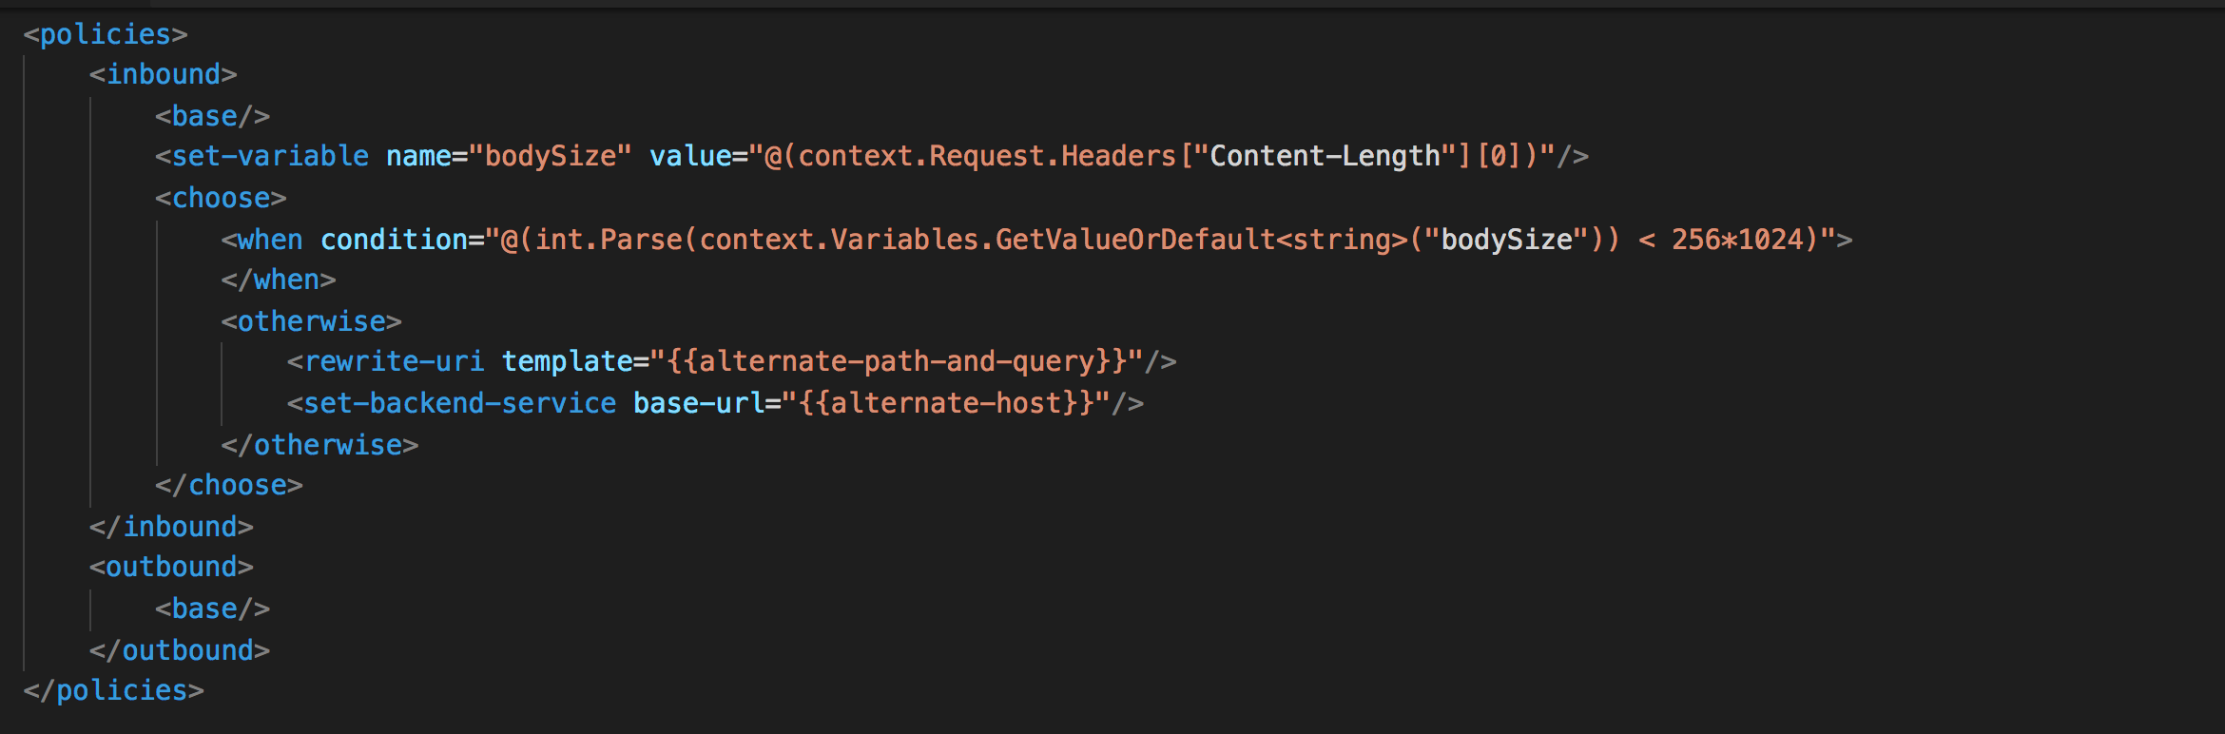
Policy scopes
Policy expressions
Named values
C# “snippets” used with policies
Read-only access to the request context
Can use whitelisted .NET types
Dynamically configure and conditionally execute policies
Shared across APIM instance
Keep secrets and “magic” strings out of policies
Add semantics, if named well
Enable a single point of change
Provide environment-specific values

Slide 26
Out of the box policies
Access restriction
Transformation
Advanced
Dapr integration
•
•
•
•
•
•
•
•
Check HTTP header
Limit call rate by subscription
Limit call rate by key
Restrict caller Ips
Set usage quota by subscription
Set usage quota by key
Validate client certificate
Validate JWT
•
•
•
•
•
•
•
•
•
•
Convert JSON to XML
Convert XML to JSON
Find and replace string in body
Mask URLs in content
Set backend service
Set body
Set HTTP header
Set query string parameter
Rewrite URL
Transform XML using XSLT
Send one way request
Send request
Set HTTP proxy
Set variable
Set request method
Set status code
Control flow
Emit metric
Log to Event Hub
Trace
Mock response
Forward request
Limit concurrency
Return response
Retry
Wait
Send request to a service
Send message to a pub/subtopic
Trigger output binding
•
•
•
•
•
•
•
•
•
•
•
•
•
•
•
•
Cross Domain •Allow cross-domain calls
•
•
•
Authentication
Caching •Get from cache
Validation policies
•
•
Authenticate with basic
Authenticate with client certificate
•
•
•
•
•
Validate content
Validate parameters
Validate headers
Validate status code
Validate GraphQLrequest
•Authenticate with managed identity
•
Store to cache
•
•
CORS
JSON
•Get value from cache
•Store value from cache
•Remove value from cache

Slide 27
Integration policies
<send-request/>
Transformation
Advanced
Response composition (or gateway aggregation)
One client request -> multiple backend requests
Data lookup, complex content transformation, payload or credential validation
Typical pattern:
1. externalize logic as an HTTP endpoint 2. make a call 3. cache the result
<send-one-way-request/>
Traffic mirroring Coordinate callouts with <wait>for allor any outstanding requests
<log-to-eventhub/>
Event Hub is widely supported within Azure
Custom reporting, batch analytics, archiving, audit
Customer has full control over what is logged, when it is logged and owns the data
We employ buffering (e.g. 200MB per node in Premium)
Delivery is not guaranteed –comprehensive set of metrics is available
It’s crucial to adequately scale the target Event Hub
Co-location in the region is highly recommended

Slide 28
Integration policies
<forward-request/>
Advanced
Request forwarding
Usually inherited from the global scope via <base/> No policy, no forwarding Timeout can be set to 30 sec –10 min (default is 5 min) Can be configured to follow redirects or (default) return them to caller
<retry/>
Retry is triggered when specified expression evaluates as true
Choice of fixed, linear or exponential back off interval
Optional fast first retry
Does NOT retain a copy of the request automatically
<limit-concurrency/>
Caps the number of concurrent requests forwarded to the backend
Can be used with other policies -limits the number of requests entering enclosed policies
<set-backend-service>
Change backend service during runtime
Can be configuredwith conditional policies for blue/green deployment

Slide 29
Integration policies
Shared among all units within a region Not persistent and thus gets lost during service updates No preloading
Caching
Distributed Redis cache hosted as part of service instance (not available in the Consumption tier)
<cache-lookup/> and <cache-store/>
Caches response if it’s smaller than 2MB
Acts as server of origin –ignores cache control headers from backend and replaces them with own
With expressions possible to use cache control settings sent from backend
vary-by-developerand vary-by-group provide additional scope control
Can be configured to cache requests with Authorization header
Properly handles conditional requests (e.g. if-match, if-modified-since)
Cache hit ratio is provided as a metric
<cache-lookup-value>& <cache-store-value>
Entity to cache and a key are specified by expressions
Invalidation
TTL or LRU
Any policy change invalidates cache entries at that scope
<cache-remove-value/>removes an entry with a specified key

Slide 30
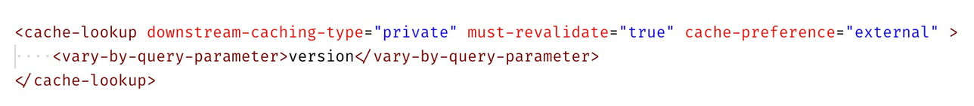
Integration policies
Bring your own cache
Add externally provisioned, Redis-compatible cache
Full control over cache configuration and size Ability to preload and purge cache content Ability to independently scale cache
Only cache option in the Consumption tier Cache policies are extended to work with external cache
Added cache-preferenceattribute
Can be set to “internal”, “external”, (default) “prefer-external”
Can use different cache types at different scopes

Slide 31
Integration policies
Throttling
Accuracy of (distributed) throttling policies is limited by synchronization latency
<rate-limit-by-key/>
Number of calls allowed in short interval (usually 1 sec)
Enforced per region
Key expression specifies throttling semantics, e.g. caller IP, subscription ID, developer ID
Uses sliding time window, i.e. last 5 seconds
Counts every request or only the ones that meet specified condition, e.g. only 200 OK
Different requests can be weighted differently, e.g. based on cost to the backend
Legacy <rate-limit/>==<rate-limit-by-key/>with subscription ID as a key
<quota-by-key/>
Total number of calls and/or bytes per time period (usually hour, day, week, month)
Enforced per service instance
Key expression specifies throttling semantics, e.g. caller IP, subscription ID, developer ID
Uses calendar time
Counts every request or only the ones that meet specified condition, e.g. status < 400
Different requests can be weighted differently, e.g. based on value provided to the caller
Legacy <quota/>== <quota-by-key/>with subscription ID as a key

Slide 32
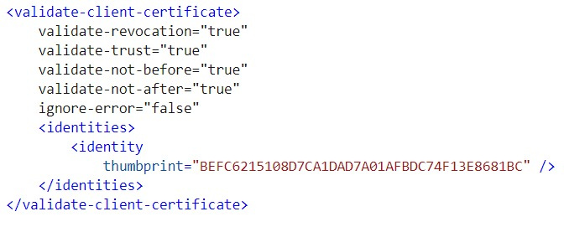
Integration policies
Authentication
Authentication using subscription keys is supported out-of-the-box without configuring policies
<validate-jwt>
validates JSON Web Tokens
Supports JWS and JWE (RSA256 and HS256)
Supports Open ID Configuration endpoint
Can also check specific claims
Can be configured at any policy scope
<validate-client-certificate>
Enforce that a certificate presented by a client matches the specified validation rules and claims, such as subject, thumbprint,or issuer

Slide 33
Integration policies
Transformation
<set-header> and <set-query-parameter>
Add/remove/modify headers and query parameters of incoming and outgoing requests
<set-body>
Set the payload of incoming and outgoing requests
<rewrite-url>
Convert request URL from its public form to the form expected by the backend service
<xml-to-json> and <json-to-xml>
Convert payload of incoming and outgoing requests between XML and JSON
<find-and-replace>
Find and replace substrings in the payload of incoming and outgoing requests
<xsl-transform>
Applies XSL transformation to XML in the payload of incoming and outgoing requests

Slide 34
Integration policies
Validation
<validate-content>
Validates the size or JSON schema of a request or response body against the API schema
<validate-parameters>
Validates the header, query, or path parameters in requests against the API schema
<validate-headers>
Validates the responses headers against the API schema
<validate-status-code>
Validates the HTTP status codes in responses against the API schema
<validate-graphql-request>
Validates and authorizes a request to a GraphQLAPI

Slide 35
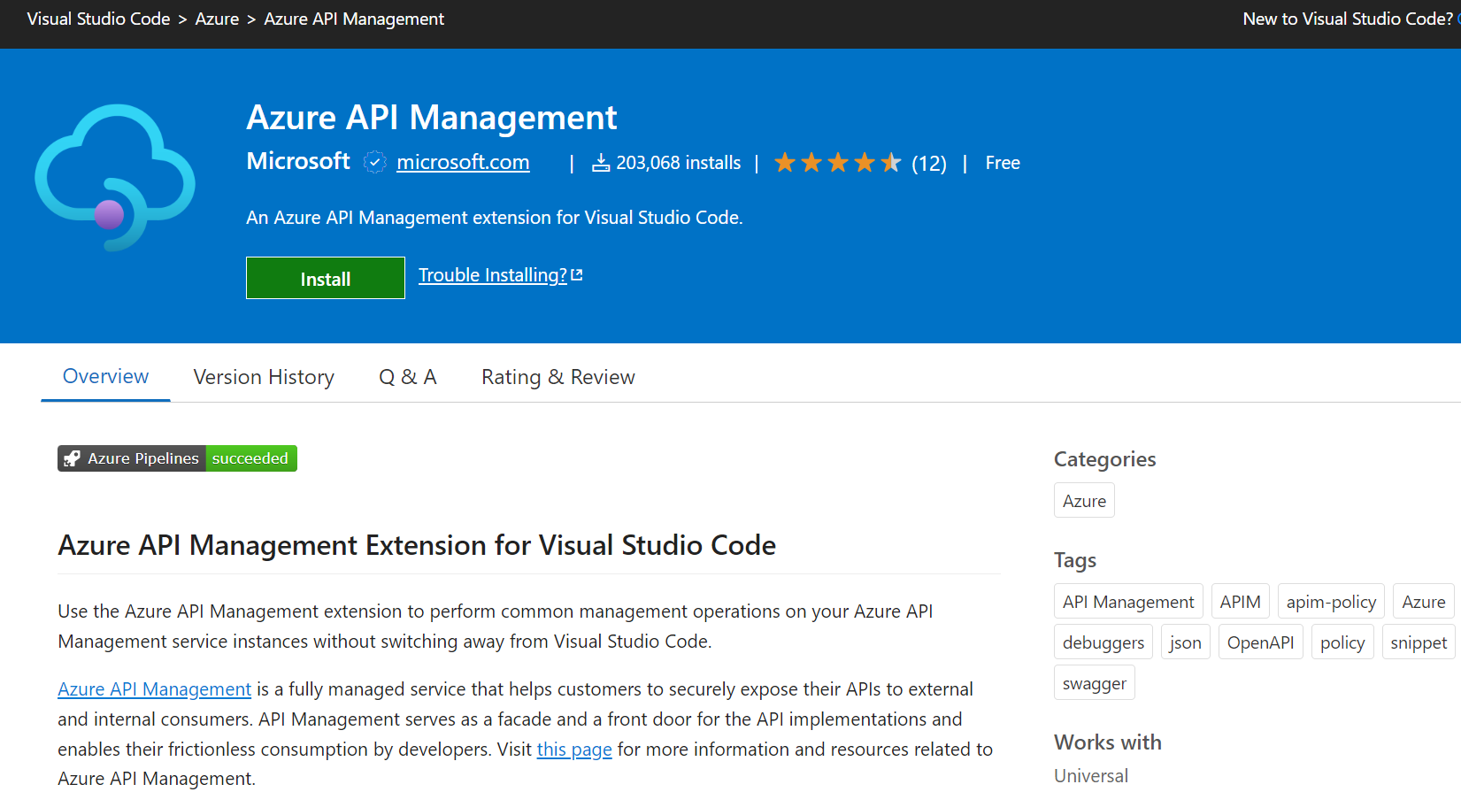
API lifecycle: design
Visual Studio Code
Designed to increase productivity Convenient resource explorer Advanced policy editor Policy debugging Syntax check and IntelliSense Embedded REST client for testing Integrated with automation tools Command palette support

Slide 36
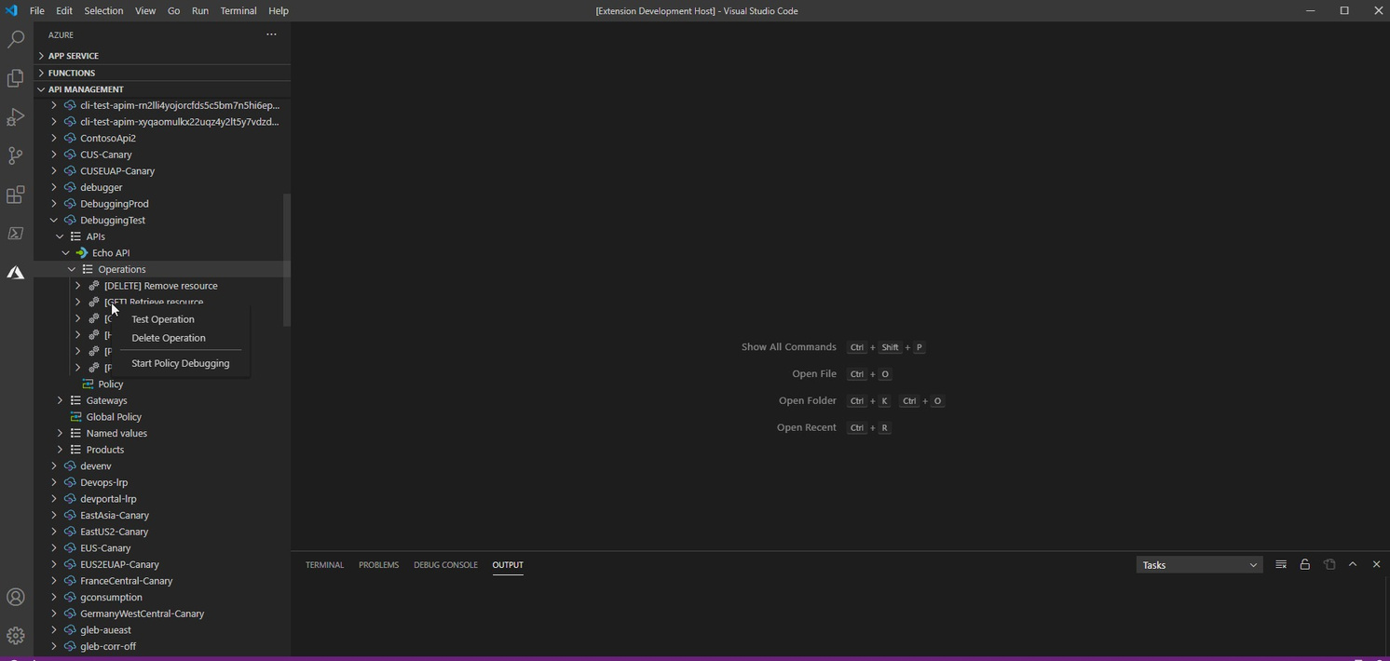
API lifecycle: design
Live policy debugging in Visual Studio Code
Postmortem debugging
Rely on logs after requests are processed
Live debugging
Follow the processing of requests in real time
Feature
Initiate live debugging session from VS Code Single-step through policies Set breakpoints at individual policies Inspect system-created and user-created variables Examine errors
Restrictions & limitations
Developer-tier only One debugging session per instance

Slide 37
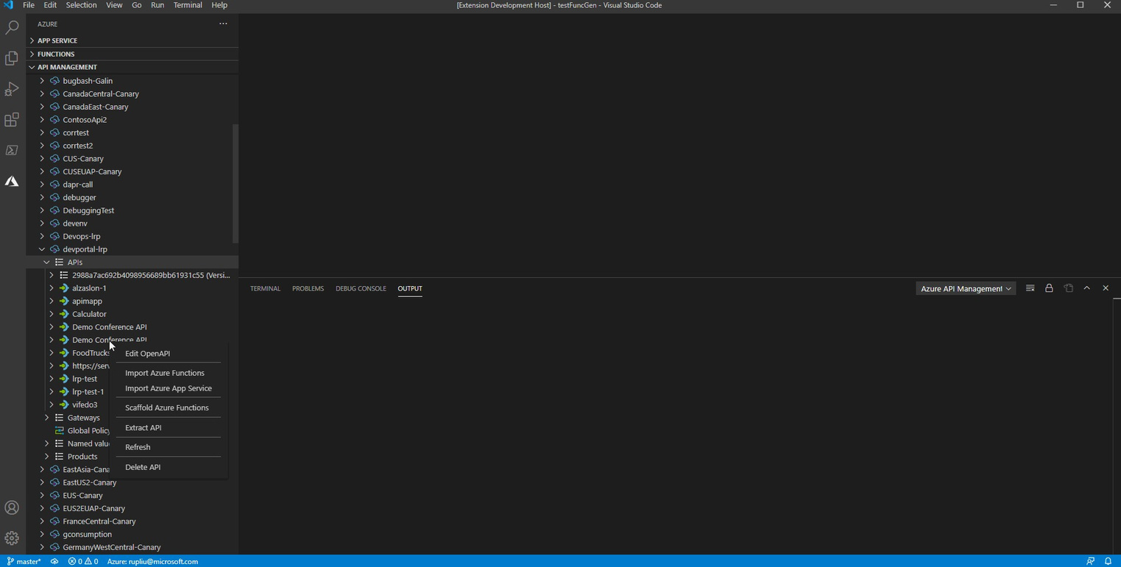
API lifecycle: design
Design-first API development
Design an API with OpenAPI spec Mock API responses to unblock front-
end developers
Scaffold Azure Functions in VS Code
Fill in the business logic
Supported languages
C# Java Python TypeScript

Slide 38
API lifecycle: design
Automate API Management deployments
Context
Multiple deployment environments, e.g. development, QA, production Some of the environments are shared, e.g. production Many API development teams each responsible for one or more APIs
Problems
Automate deployment of APIs into API Management Migrate configurations from one environment to another Avoid interference between development teams
There is no one-size-fit-all solution

Slide 39
API lifecycle: design
APIs PowerShell Cmdlets Azure CLI
Resource Manager Templates Bicep
Terraform
SDKs
Deployment options

Slide 40
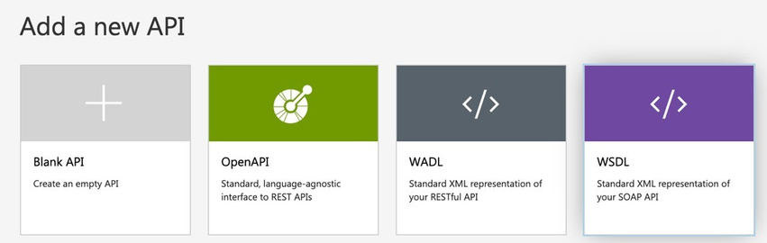
API lifecycle: design
SOAP-to-REST
One-click modernization of legacy services Import a WSDL, get a REST API façade instantly APIM does all the conversions using heuristics Customers have full control of the conversions through policies Known restrictions.

Slide 41
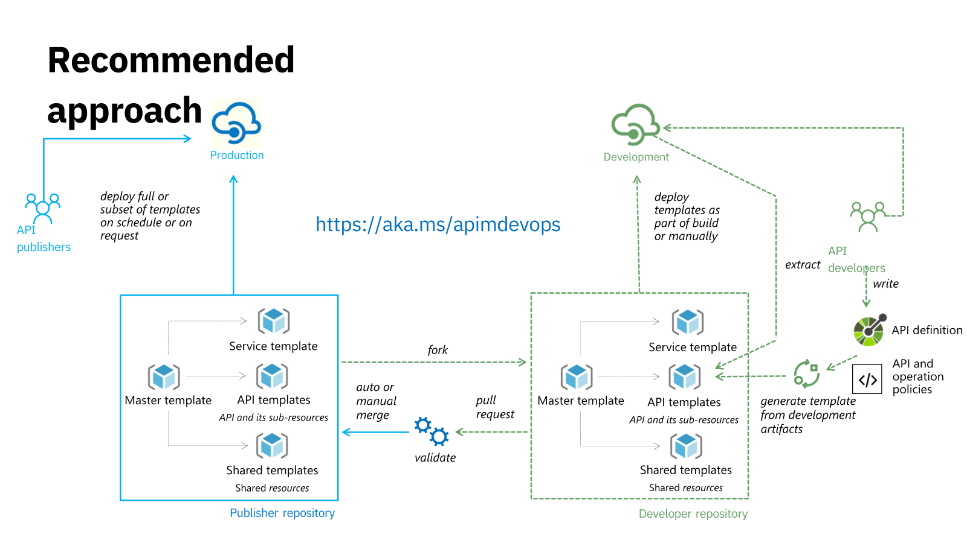
API lifecycle: design

Slide 42
Full API lifecycle
Design
Develop
Secure
Publish
Scale
Monitor
Analyze

Slide 43
API Management to the rescue
#
1 2
OWASP API Top 10 (2023)
Broken Object Level Authorization Broken Authentication
Mitigations and preventive measures in API Management
Key/token/certificate-based authentication Request transformation
Filtering or masking sensitive data
Request and response validation
Throttling and quota limit
Backend concurrency
Key/token-based authorization
Custom authorization
Request and response validation
Server-Side Request Forgery (SSRF) flaws can occur when an API is fetching a remote resource without validating the user-supplied URI.Request and response validation
Up-to-date API catalog
API lifecycle management
APIs tend to expose more endpoints than traditional web applications, making proper and updated documentation highly important.
3
Broken Object Property Level Authorization
4
Unrestricted Resource Consumption
5
Broken Function Level Authorization
6
7
Unrestricted Access to Sensitive Business Flows
Server-Side Request Forgery
8 9
Security Misconfiguration
Improper Inventory Management
10
Insufficient logging and monitoring

Slide 44



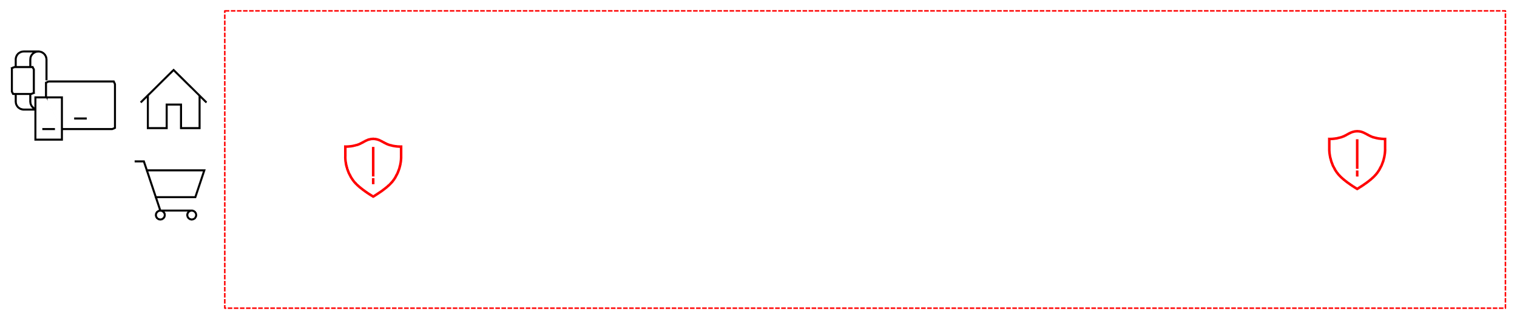


Secure all points of interaction
“User plane”
API
Management plane
App developers
Management
API providers
plane
Developer portal
Data plane
Gateway
Backend APIs
Apps on devices

Slide 45
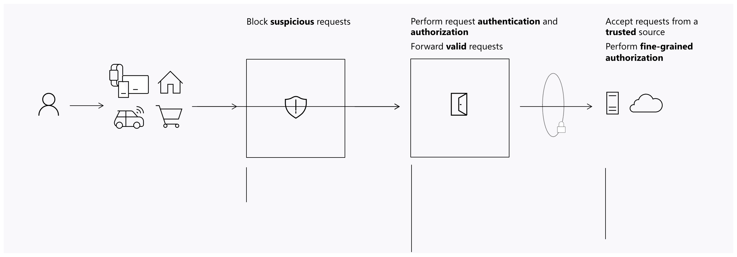
Data plane security
Data plane security
Layered defense
Separation of responsibilities between the layers
Secure and protect backend APIs
User
App on a device
Firewall
Gateway
Backend APIs
OWASP core rule sets Bot protection rule set
Custom rules
Façade Key OAuth 2 Client certificate Custom authN/authZ IP filter Request/response validation Throttling
HTTP Basic (shared secret) Mutual certificate OAuth 2 OBO Managed identity IP filter Private networking

Slide 46
Data plane security
Expose selected backend APIs Allow chosen HTTP methods and routes Enforce TLS and its configuration Define CORS rules Restrict client IPs
Facade

Slide 47
Data plane security
Turned on and UUID by default Can be rotated and set to custom values Identify developer and app Roughly equivalent to HTTP Basic
security-wise
Keys

Slide 48
Data plane security
Signed (JWS) and encrypted (JWE) Validate via policy and expressions Enforce claims Require signatures and expiration time Provide keys inline or via a metadata
endpoint
JWT

Slide 49
Data plane security
Issued by trusted and untrusted CA Use the validate-client-certificate policy Require certificate on per host basis Check or ignore revocation lists
Client
certificates

Slide 50
Data plane security
Integrate with a bespoke or unsupported identity or authorization system
Call out to an external HTTPS endpoint
Cache the result for efficiency
Custom authentication
and authorization

Slide 51
Data plane security
Rate limit
Approximate Per region Key expression defines throttling semantics
Can count requests with specific status code
Variable increment count
Throttling
Quota
Calls and data transfer Approximate Per service Key expression defines throttling semantics Can count requests with specific status code Variable increment count
Concurrency limit
Precise Per node

Slide 52
Data plane security
Filter or mask confidential data Standardize error messages Remove sensitive headers
Response sanitization

Slide 53
Data plane security
Validation policies
Four policies
Validate content -validates the size or JSON schema of a request or response body against the API schema Validate parameters -validates the request header, query, or path parameters against the API schema Validate headers -validates the response headers against the API schema Validate status code -validates the HTTP status codes in responses against the API schema
Prevention and detection modes Granular overrides for child elements Logging of errors to a context variable
Use the tracing policy to send logs to Application Insights
Performance implications and limits
Max body size: 100 kB Max schema size: 4 MB The larger the API schema size, the lower the throughput The larger the payload in a request or response, the lower the throughput The size of the API schema has a larger impact on performance than the size of the payload
Validation against an API schema that is several megabytes in size may cause request or response timeouts

Slide 54
Data plane security
Mass assignment
Attackers modify object properties they are not supposed to
Usually caused by binding client-provided data (e.g., JSON) to data models, without explicit filtering of properties Attackers explore other API endpoints, read documentation, or blindly guess additional object properties Attackers inject additional object properties into request payloads
Mitigation
Set the “additionalProperties” option of request objects’ JSON schemas to false Precisely define request object schemas in the API specification and enforce them with the validate-content policy
<validate-content unspecified-content-type-action="prevent" max-size="102400" size- exceeded-action="prevent">
<content type="application/json" validate-as="json" action="prevent" />
</validate-content>

Slide 55
Data plane security
Injection
Malicious data in a request executes unintended commands or accesses data without proper authorization
For example, SQL or NoSQL injection
Mitigation
Provide format properties, like regex for text fields, in the API specification’s object schemas and enforce them with the validate-content policy
<validate-content unspecified-content-type-action="prevent" max-size="102400" size- exceeded-action="prevent">
<content type="application/json" validate-as="json" action="prevent" />
</validate-content>

Slide 56
Data plane security
Excessive data exposure
API responses surface sensitive or excessive data
Developers tend to expose all object properties without considering their individual sensitivity They rely on clients to perform the data filtering before displaying it to the user
Mitigation
Set the “additionalProperties” option of response objects’ JSON schemas to false Precisely define response object schemas in the API specification and enforce them with the validate-content policy Define all allowed response status codes in the API specification and enforce them with the validate-status-code policy Precisely define all allowed response headers in the API specification and enforce them with the validate-headers policy
<validate-headers specified-header-action="prevent" unspecified-header- action="prevent"/>
<validate-status-code unspecified-status-code-action="prevent" />

Slide 57
Data plane security
DoS large payload attack
Large-payload requests cause API outages
Malicious requests block the API traffic on system’s bottlenecks They occupy networking resources and consume excessive computing power
Mitigation
Enforce maximum request content size with the content-validation policy
<validate-content max-size="102400" size-exceeded-action="prevent" unspecified-content-type-action="prevent" />

Slide 58
Private networking
and
upstream security

Slide 59
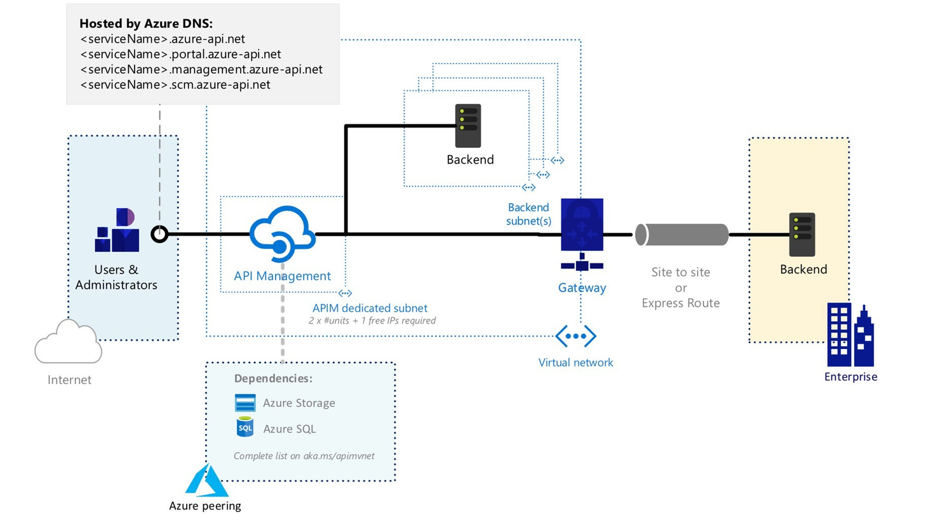
External configuration

Slide 60
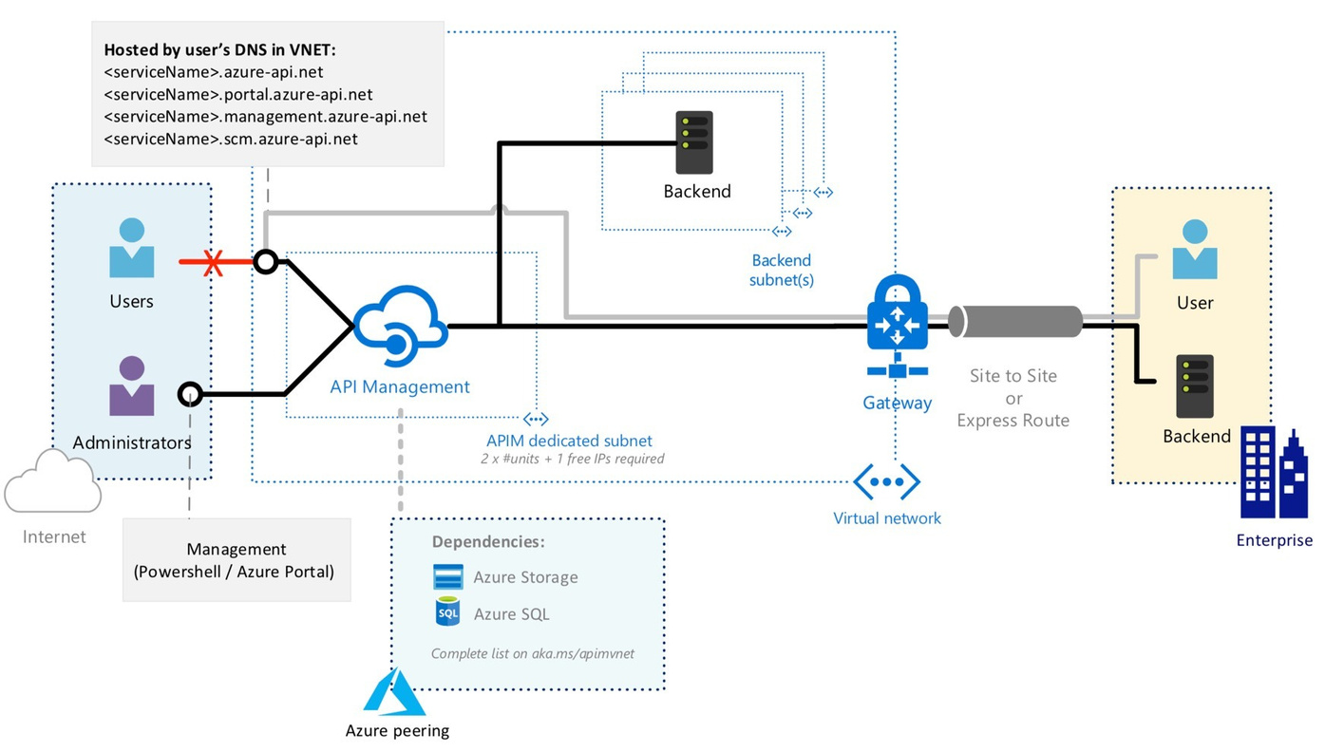
Internal configuration

Slide 61
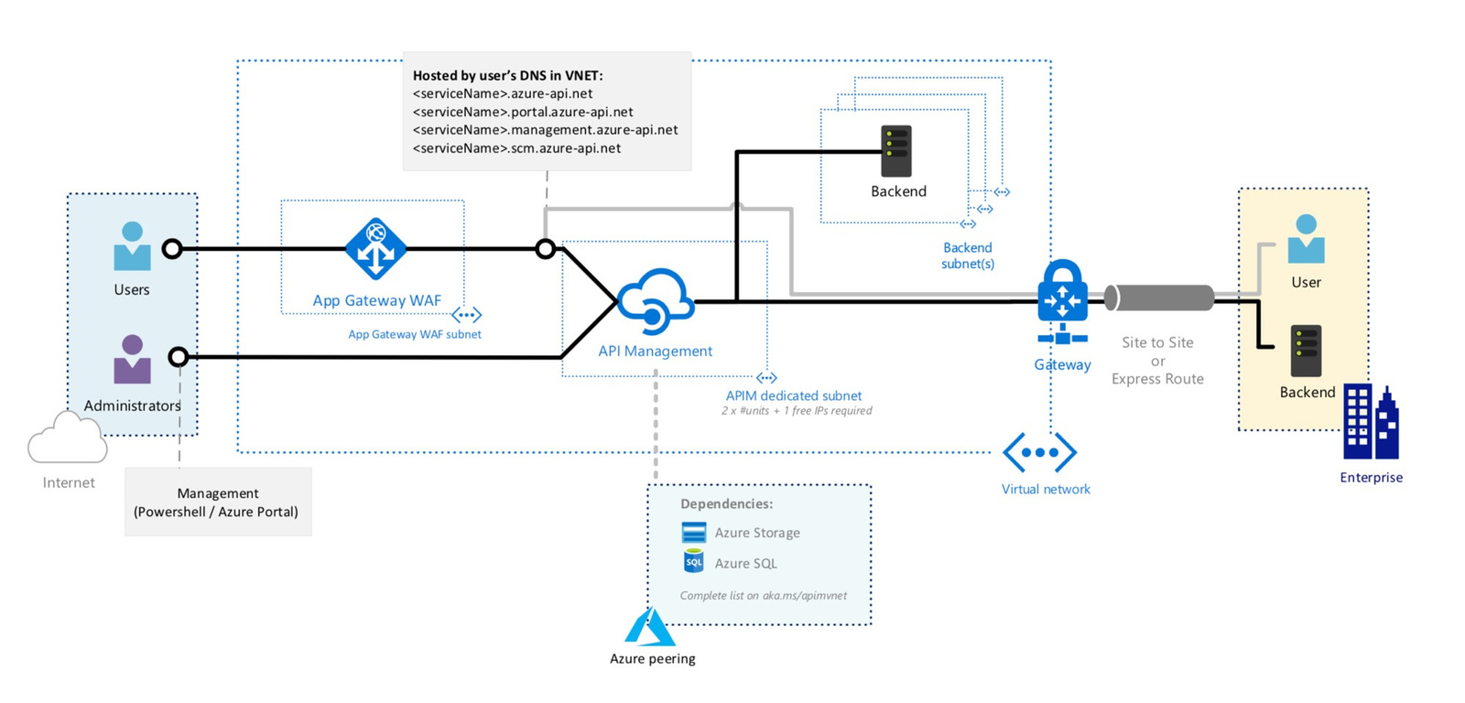
Internal configuration with WAF

Slide 62
Compliance
Compliance
Meets a multitude of global, regional, country and industry specific regulations
ISO 27001 PCI DSS HIPAA FedRAMP High GDPR …
Full list and documentation available on https://aka.ms/apim/trusted

Slide 63
Full API lifecycle
Design
Develop
Secure
Publish
Scale
Monitor
Analyze

Slide 64
Developer Portal
Developer portal is a discovery and self-onboarding point for application developers
Discover APIs
Built-in developer portal lets API consumers
Learn how to use them
Test them out with interactive console
Create and manage accounts
Request and manage API access
Analyze API usage

Slide 65
Developer Portal
Developer portal is…
Built-into API Management
Open the portal within seconds; updates are on us.
Fast go-to-market
Rely on default styling and content to minimize customizations.
Easily customizable
Author content and brand the portal with a drag-and-drop visual editor.
Open-source
Browse the codebase and engage with the community on GitHub.
Extensible
Extend the codebase with custom logic and self-host the resulting portal.
Automatable
Automate deployments via APIs.

Slide 66
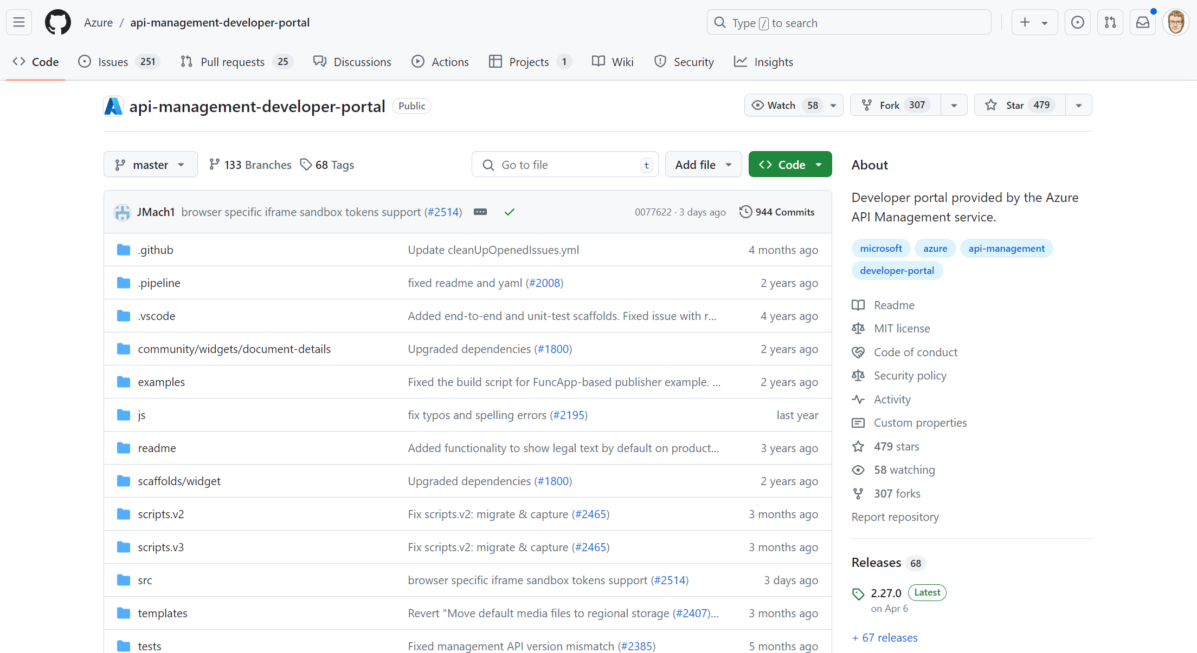
Developer Portal

Slide 67
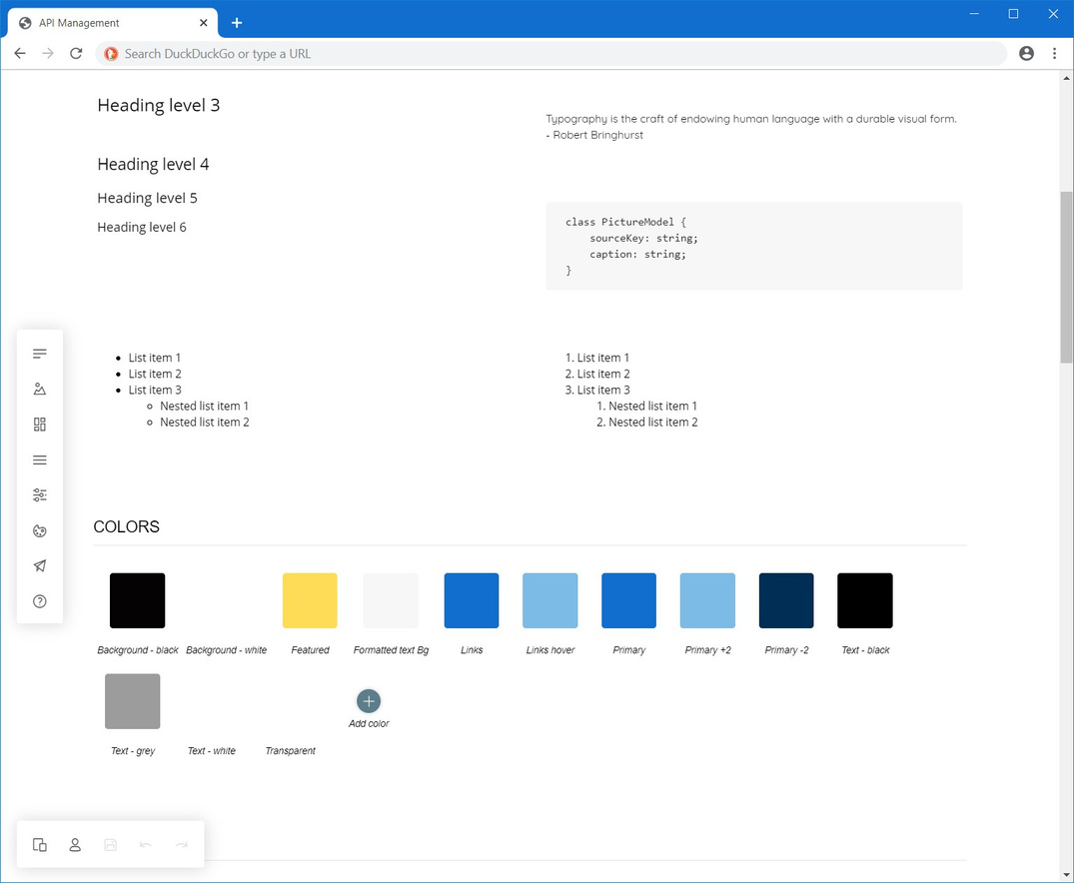
Developer Portal
Portal customizations
Create content with the drag- and-drop visual editor without writing any code
Use widgets to connect to the
API Management service (i.e., to
retrieve the list of APIs or sign in
a user)
Customize the portal in a
dedicated style guide panel

Slide 68
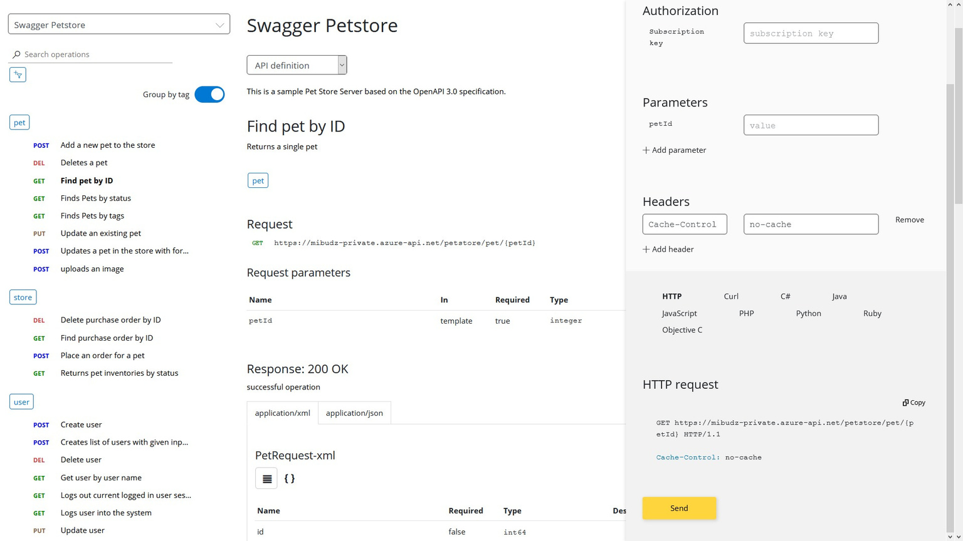
Developer Portal

Slide 69
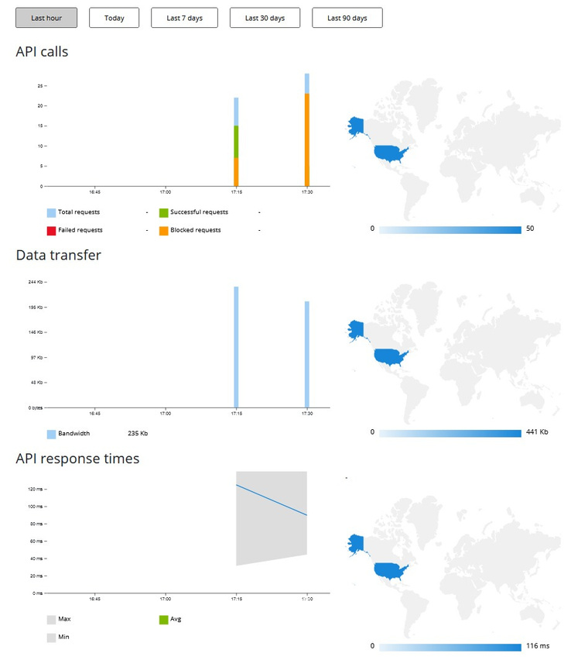
Developer Portal
API usage reports
Application developers explore their usage of APIs in the developer portal
API providers analyze the usage
in the Azure portal
Reports are grouped by time,
response type, bandwidth,
products, subscription keys, APIs,
and API operations

Slide 70
Developer Portal
Extensibility of the developer portal
If the out-of-the-box capabilities are insufficient, you can:
• • •
Request a feature on GitHub Contribute code on GitHub Fork the repository, extend the code base, and self-host the portal
Self-hosting the portal is simple and efficient
Portal generates static files for hosting in the cloud or on premises Recommended hosting with Azure Storage Account

Slide 71
Versions & Revisions

Slide 72
API Versioning
API versioning
Revisions For non-breaking changes Providers choose when to deploy API requests default to current revision Test by specifying revision ID, then promote
Versions For breaking changes Consumers choose when to adopt Specify with URL path, query, or header param

Slide 73
Use revisions when
You make a non-breaking change to your API
You may want to roll-back your changes
You want to give your developer community details of your changes

Slide 74
Use versions when
You need to show developers a relationship between APIs
You need to give developers a predictable way to switch between related APIs
You want to add breaking changes
You want to try out changes and solicit feedback from your community

Slide 75
Versions and Revisions
Domain
API
Versions
Revision
;rev=1 ;rev=2 ;rev=3 ;rev=4
/v1
/speakers /sessions /days
https://example.org/
foo
/events /speakers /sessions /venues
/v2
;rev=1 ;rev=2
offline online current

Slide 76
Bundle APIs with Products
Developer portal Browse products and associated APIs
Subscribe to products
Manage subscriptions and keys
API 1
Management plane Manage products and API associations
Define product-scoped policies
Approve and manage subscriptions
Collect and analyze usage data
Monetize access
API 2
API 3
Gateway Authenticate API requests with keys
Execute product-scoped policies
API 4

Slide 77
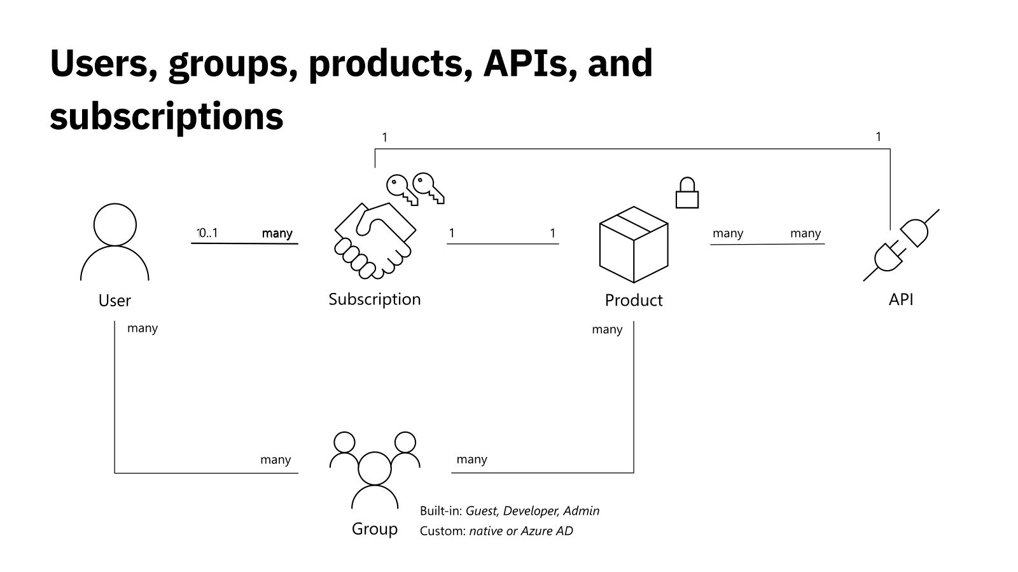
Users, Groups, Products, APIs and subscriptions

Slide 78
APIOps

Slide 79
APIOps
APIOps places the Azure API Management infrastructure under version control to achieve these goals. Rather than making changes directly in API Management portal, most operations happen through code changes that can be reviewed and audited. In this section we include links to both a complementary Guide and Wiki to get you started with the tool.

Slide 80
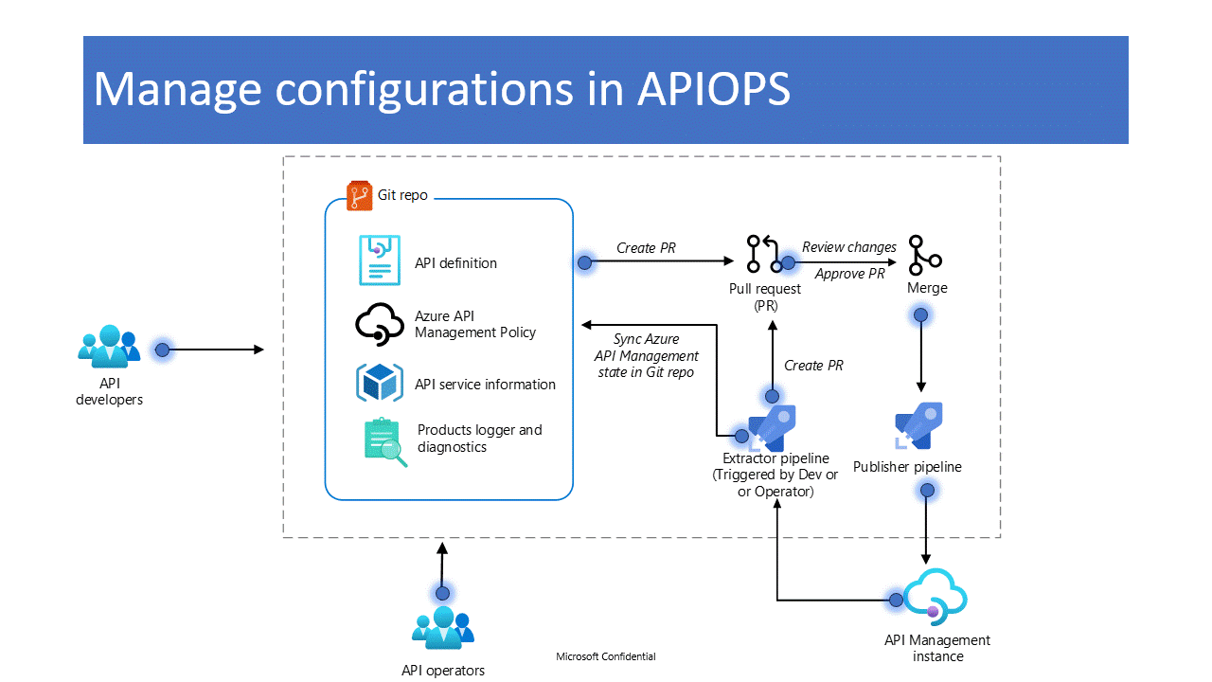
APIOps
https://azure.github.io/apiops/

Slide 81
Full API lifecycle
Design
Develop
Secure
Publish
Scale
Monitor
Analyze

Slide 82
Global presence
Worldwide presence
44 public regions in Americas, Europe, Asia, Australia, Africa 6 US Government regions 4 regions in China
Browse all available regions on azure.microsoft.com

Slide 83

Anatomy of an Azure API Management instance
https://<service-name>.azure-api.net
Azure API Management instance with 1 unit (*)
Machine #1
Machine #2
Control-Plane
Control-Plane
Gateway
Gateway
Developer Portal
Developer Portal

Slide 84
Multi-region
Improved availability of the data plane –99.99% vs 99.95% SLA Reduced latency of API calls
Single Premium instance can be scaled across multiple regions
Additional units can be deployed into the Primary or other Secondary region Regions can have a different number of units Regions and units come at an additional cost.
Primary region hosts all the components
Gateway, developer portal, management API, Developer portal and management API are inaccessible if Primary region becomes unavailable.
Secondary region hosts gateway only
Secondaries can operate on a last received configuration while the Primary region is unavailable, They periodically try to reconnect and catch up.
All APIs are available in every region Requests are routed to the closest available region by Azure Traffic Manager.
Uses Traffic Manager’s performance routing with 5min TTL

Slide 85









Multi-region
Primary region
Secondary region
Shared state

Slide 86

Anatomy of an Azure API Management instance
https://<service-name>.azure-api.net
https://<service-name>-australiaeast-01.regional.azure.api.net
https://<service-name>-australiasoutheast-01.regional.azure.api.net
Primary region
Secondary region
Control-Plane
Control-Plane
Gateway
Gateway
Gateway
Gateway
Developer Portal
Developer Portal

Slide 87










Multi-region
Secondary
Regions
Primary Region
Secondary Region
Shared state
Shared state

Slide 88
Availability zones
Obtain 99.99% SLA with two (or more) zones in a single region
Improve resiliency of the primary region in a
multi-region deployment
Each unit contains all API Management
components
Units must be evenly distributed across zones
Available in the Premium tier in every AZ-
enabled Azure region
Availability Zones

Slide 89



Self-Hosted API Gateway
Functionally equivalent to the managed gateway Packaged as a Linux-based Docker container image Available from the Microsoft Container Registry
Deployable to on-premises or cloud
Requires only outgoing connectivity to Azure on port 443 Connects to a “parent” API Management service Pulls down configuration and pushes up telemetry
Managed and observed from Azure
Just a single container Easy to evaluate on a laptop with Docker Desktop or Minikube Kubernetes provides availability, scaling, rolling upgrades, and more
Simple to provision and operate

Slide 90
Self-Hosted API Gateway
Self-hosted gateway pricing
Developer tier
Pre-production environments Unlimited gateway locations Single node per location No additional charge
Premium tier
Production environments Unlimited gateway locations Unlimited nodes per location Paid add-on
Nodes in a gateway location share configuration –e.g., APIs, domain names, certificates

Slide 91











Dapr integration policies
Invoke a service | Send a message to a pub/subtopic | Trigger an outbound binding
API Managers
API Consumers
API Management
Self-hosted gateway 1
Self-hosted gateway 2
Sidecar
Sidecar
Gateway pod
Gateway pod
Sidecar
Sidecar
Sidecar
Sidecar
Legend:
User App
User App
User App
User App
Management Plane Data Plane
App 1 pod
App 2 pod
App 1 pod
App 3 pod
Kubernetes cluster 1
Kubernetes cluster 2

Slide 92
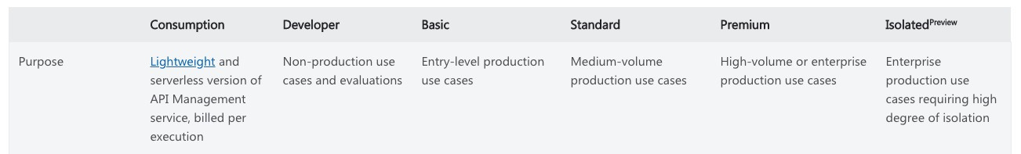
Isolated SKU
Isolated SKU
Same capabilities as the Premium SKU Ensures compute isolation Meets US Department of Defense IL5 requirements

Slide 93
Backup & restore for disaster recovery
Backup
Usually takes around 10 min Captures everything but reports and custom domain settings in a blob Service configuration operations (e.g., scaling, upgrades) are blocked while backup is in progress Changes applied after backup starts are not included in the backup
Restore
Could take as long as 30 min or more depending on the size Instance is not available while restore is in progress Custom domain configuration need to be re-applied manually
Standby failover instance can reduce RTO
Create backup instance in a different region in advance Configure custom domain identically to the active instance Sync configuration with the active instance periodically to achieve desired RPO To fail over update the CNAME to reference backup instance Scale up if and as required

Slide 94
Troubleshooting & Support
SLA
99.95% in all tiers 99.99% in the Premium tier with multi-region configured
Self-troubleshoot
Built-in automated troubleshooting experiences in the Azure portal Extensive documentation on Azure Docs
Supported by Azure Support
Requires support plan Available worldwide in nine languages: English, Spanish, French, German, Italian, Portuguese,
Traditional Chinese, Korean, and Japanese
24x7 in English for severity A and B and in Japanese for severity A

Slide 95
Full API lifecycle
Design
Develop
Secure
Publish
Scale
Monitor
Analyze

Slide 96
Monitor and analyze features
Tech
Reporting
Monitoring
Debugging
Data lag
Retention
Sampling
Data schema
Data kind
Enabled
API inspector
-
-
Good
Instant
Last 100 traces
Turned on per request
Fixed
can be extended
Request trace
Always
Built-in reports
Good
-
-
Minutes
Unspecified
100%
Fixed
Reports Logs via API
Always
Azure Monitor Metrics
93 days
export to extend
Basic
Good
-
Minutes
100%
Fixed
Metrics
Always
Azure
Good
Good
Good
Minutes
31 day(5GB)
upgrade to extend
100%
adjustable
Fixed
can be extended
Logs
Optional
Monitor Logs
Application
90 days (5GB)
upgrade to extend
Choice of
Insights
Good
Good
Good
Seconds
Custom
presets
can be extended
Logs, metrics
Optional
Log to Event
Custom
Custom
Custom
Seconds
User managed
Custom
Custom
Logs
Optional
Hub

Slide 97
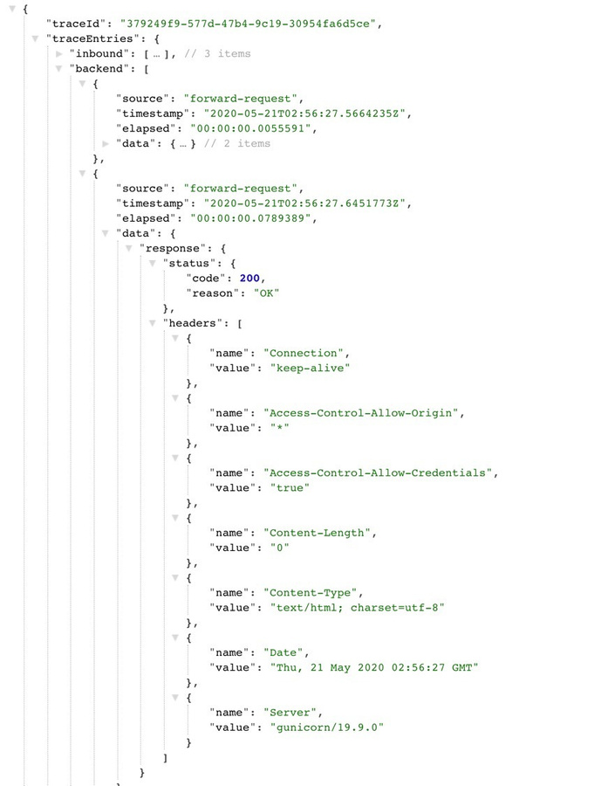
Monitor and analyze features
API Inspector
Request scoped trace Turned on per request Fixed schema (can be extended)

Slide 98
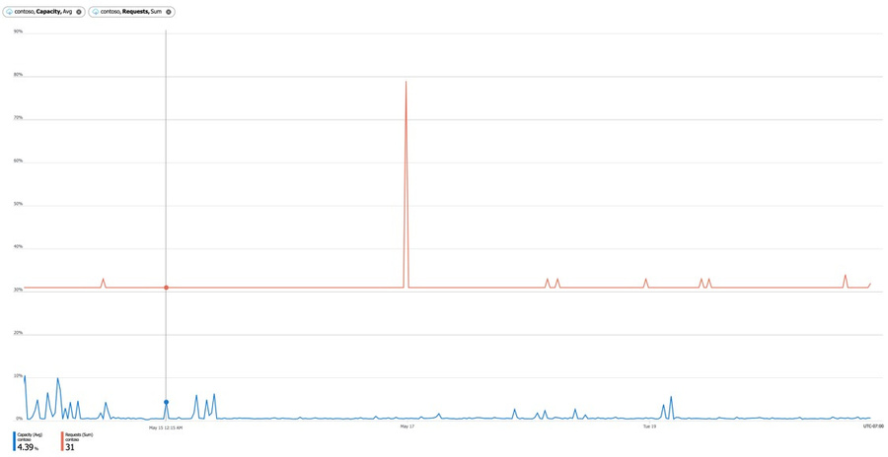
Monitor and analyze features
Azure Monitor metrics
Aggregated metrics Always-on Samples all requests 93-day retention Alerts and notifications

Slide 99
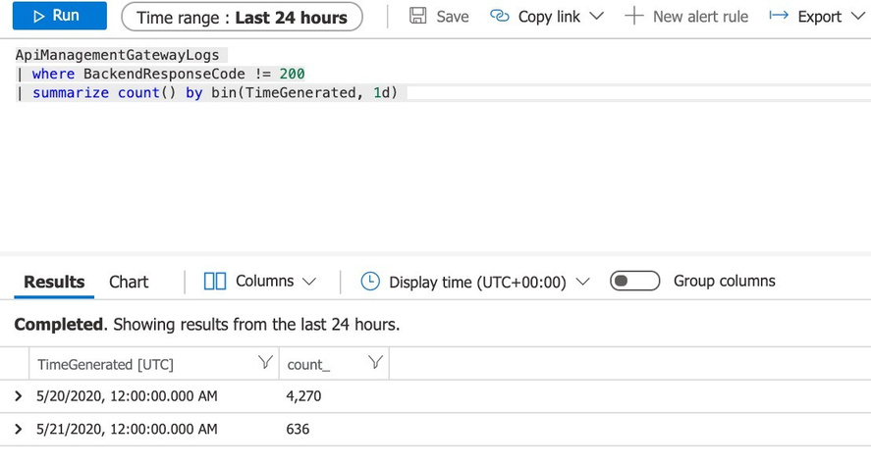
Monitor and analyze features
Azure Monitor logs
Request scoped logs Opt-in Adjustable sampling Fixed schema (can be extended) 31-day retention (5GB) Built-in query experience

Slide 100
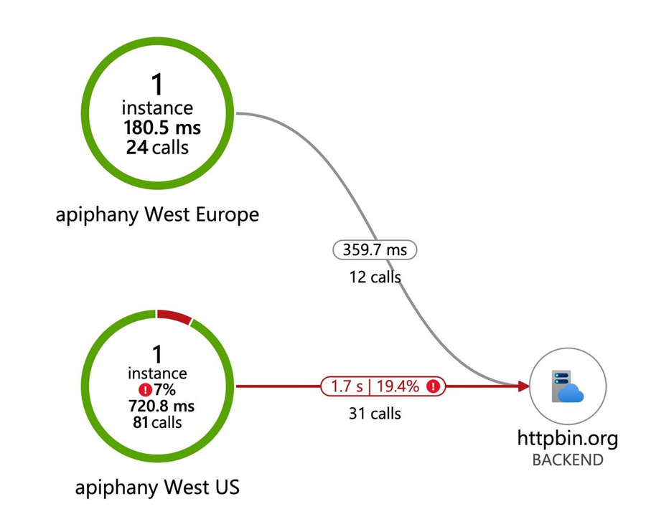
Monitor and analyze features
Application Insights
Request scoped traces Opt-in Adjustable sampling 90-day retention (5GB) Distributed tracing

Slide 101
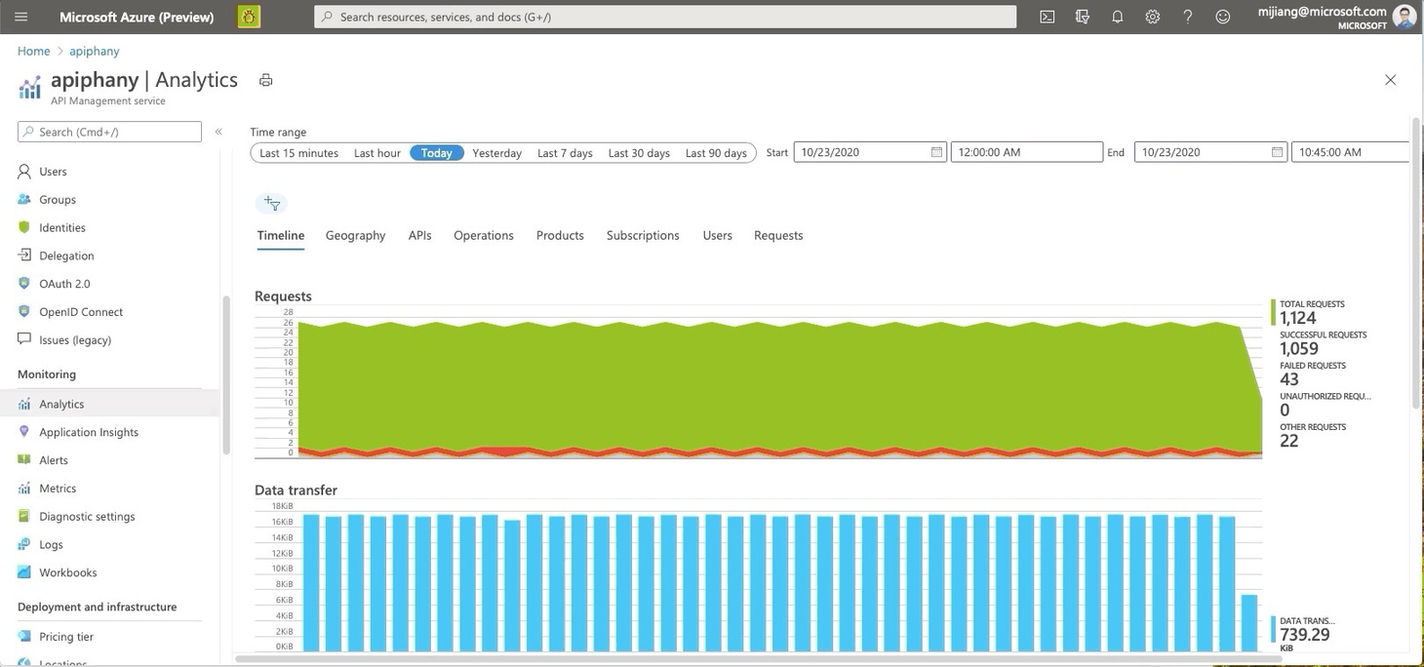
Monitor and analyze features
Built-in reports
Out-of-the-box Always-on Rich report types
Access via Azure portal or API

Slide 102












Custom analytics & reporting
Machine Learning
SQL Database
Event Hub
Stream Analytics
Power BI
Hadoop
Storage
Business users
(Azure account is not required)
Gateway
Data plane
Apps on devices
(micro)services

Slide 103
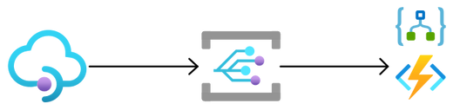

Custom analytics & reporting
Event Grid integration
Events publisher
Events subscribers
Logic App
Function App
API
Event Grid
Webhook
Management
Integration with Event Grid
Send event notifications to Event Grid system topic of type Microsoft.ApiManagement Trigger downstream processes on Azure Logic App, Azure Functions or via Webhook Published events are CRUD of API, Product, Release, Subscriptions, User *

Slide 104
AI Gateway
APIM 🩷 OpenAI

Slide 105
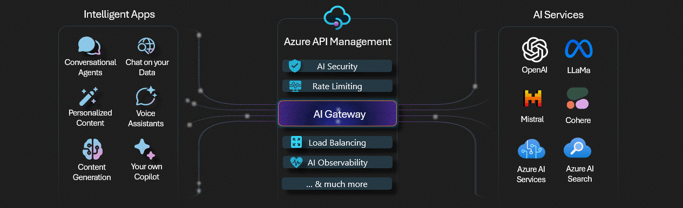
APIM AI Gateway capabilities
http://aka.ms/ai-gateway

Slide 106



APIM AI Gateway objectives
Aims to accelerate the experimentation of advanced AI use cases
Ensures control and governance over the consumption of AI services
Paves the road for a confident deployment of Intelligent Apps into production

Slide 107





APIM AI Gateway toolchain
VS Code
Jupyter Notebooks
Python
Bicep
Azure CLI
Powered by VS Code running locally or in the cloud with GitHub Codespaces
Jupyter Notebooks structures the step-by-step instructions
Python scripts define the variables and execute OpenAI API calls directly or with SDKs
Bicep defines the infrastructure as code needed for the lab in a declarative way
Azure CLI handles authentication with Azure and issues commands to the control plane

Slide 108
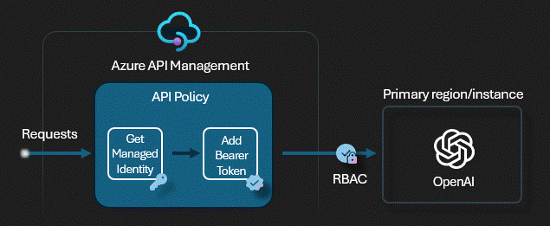
Request forwarding
Playground to try forwarding requests to either an Azure OpenAI endpoint or a mock server
APIM uses the managed identity (user or system assigned).
APIM is authorized to consume the Azure OpenAI API through Role Based Access Controls.
Zero impact on consumers using the API directly, with SDKs or orchestrators like LangChain. Just need to update the endpoint to use the APIM endpoint instead of Azure OpenAI endpoint.
Keyless approach: API consumers use the APIM subscription keys, and the Azure OpenAI keys are never used.

Slide 109

Backend circuit breaking
Playground to try the built-in backend circuit breaker functionality of APIM to either an Azure OpenAI endpoint or a mock server
Azure OpenAI endpoint is configured as an APIM backend, promoting reusability across APIs and improved governance.
Circuit breaking rules define controlled availability for the OpenAI endpoint.
When the circuit breaks, APIM stops sending requests to OpenAI.
Handles the status code 429 (Too Many Requests) and any other status code sent by the OpenAI service.
Doesn’t need any policy configuration. The rules are just properties of the backend.

Slide 110
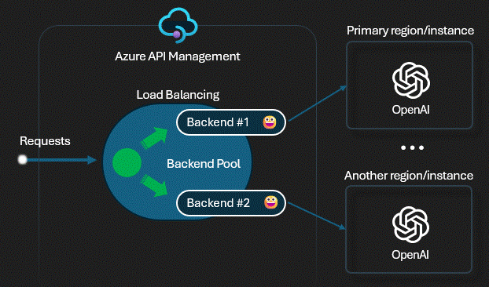
Backend pool load balancing
Playground to try the built-in load balancing backend pool functionality of APIM to either a list of Azure OpenAI endpoints or mock servers
Spread the load to multiple backends, which may have individual backend circuit breakers.
Shift the load from one set of backends to another for upgrade (blue-green deployment).
Currently, the backend pool supports round-robin load balancing.
Doesn’t need any policy configuration. The rules are just properties of the backend.

Slide 111
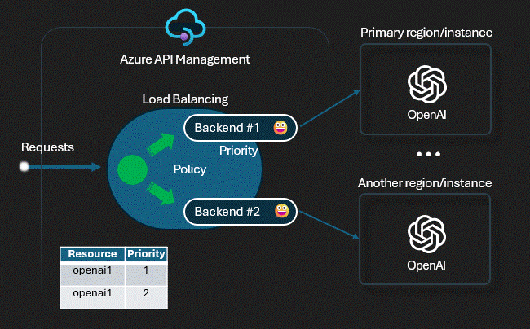
Advanced load balancing
Playground to try the advanced load balancing (based on a custom APIM policy) to either a list of Azure OpenAI endpoints or mock servers
Loads the load balancer configuration from a named value property.
Uses backends to enable the combination with the built-in circuit breaking feature or chaining with the backend pool.
The policy doesn't have to be changed to add/modify endpoints or configure the load balancer.
Dynamically supports any number of OpenAI endpoints.
Support advanced properties like priority or weights to give priority to Provisioned Throughput Unit (PTU) instances.

Slide 112
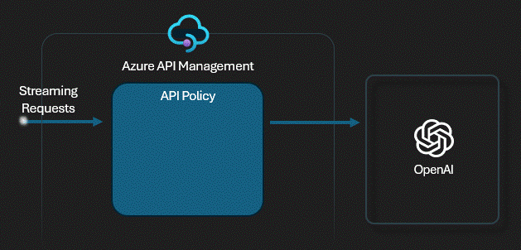
Response streaming
Playground to try response streaming with APIM and Azure OpenAI endpoints to explore the advantages and shortcomings associated with streaming
The client application receives the completions in chunks as it's being generated.
Might improve the user experience for intelligent apps with a ChatGPT interface.
Streaming responses doesn't include the usage field to tell how many tokens were consumed.
You sacrifice for now APIM built-in logging .
Streaming in a production application makes it more difficult to moderate the content of the completions, as partial completions may be more difficult to evaluate.

Slide 113
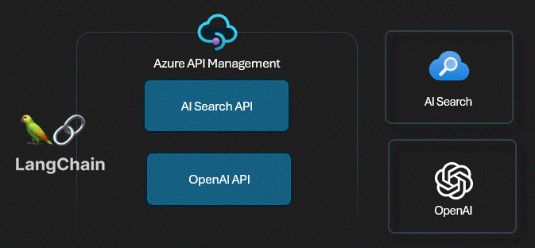
Vector searching
Playground to try the Retrieval Augmented Generation (RAG) pattern with Azure AI Search, Azure OpenAI embeddings and Azure OpenAI completions
Implements the popular RAG pattern
Uses Azure AI Search as a vector store
Uses OpenAI to generate the embeddings
Supports key word search, hybrid search and semantic ranking.
OpenAI completion is generated based on the user prompt and the AI search results.
All the APIs from OpenAI and AI Search are served trough APIM without using keys.

Slide 114
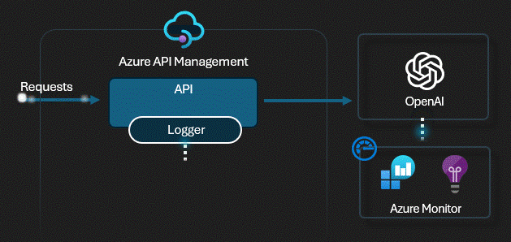
Built-in logging
Playground to try the built-in logging capabilities of API Management
The requests are logged into Application Insights and metrics available in Azure Monitor.
Doesn’t need any policy configuration.
Enables tracking request/response details and token usage with the provided notebook.
Metrics from the Azure OpenAI service might be correlated to provide a holistic view on service usage.
The notebook can be easily customized to accommodate specific use cases.
Enables the creation of Azure dashboards for a single pane of glass monitoring approach.

Slide 115
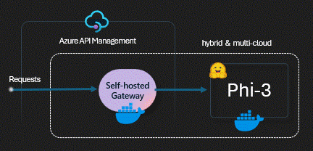
SLM self-hosting
Playground to try the self-hosted phy-3 Small Language Model (SLM) through the APIM self-hosted gateway with OpenAI API compatibility.
The APIM self-hosted gateway is a containerized version of the default managed gateway.
Useful for scenarios where we need to self-host an open-source model from platforms such as Hugging Face.
In this playground we have used Phi-3 that is a SLM suited to try on a laptop.
Both APIM self-hosted gateway and the phy-3 could run on docker containers or in a Kubernetes cluster.

Slide 116
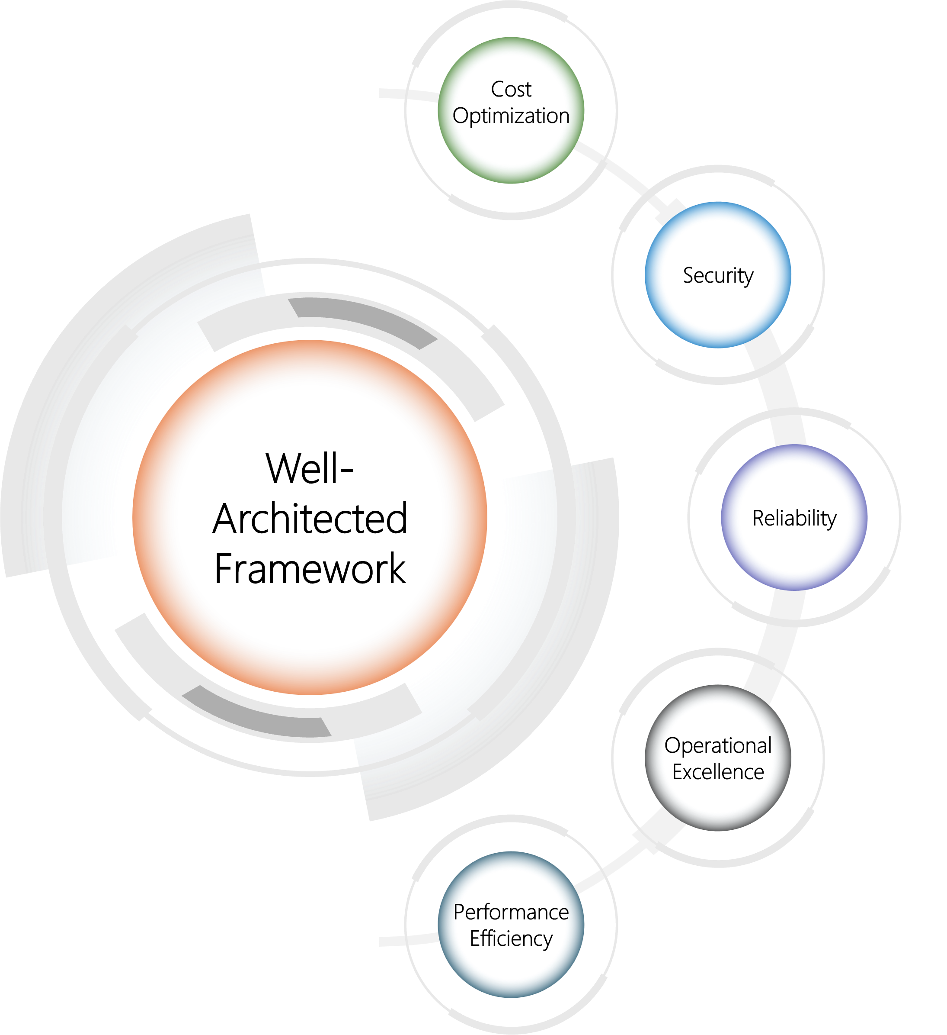
Built with Well-Architected principles
Zero-trust approach and keyless strategy for Azure OpenAI
Redundancy and capable of handling variable usage spikes
Elasticity and mechanisms to distribute the load to multiple endpoints
Observability to continuously improve quality and user experience
Cost control mechanisms to track token usage and allocate costs
https://learn.microsoft.com/en-us/azure/well-architected/

Slide 117
Architecting for Azure

Slide 118
Architecting for Azure
Considerations
What type of APIs are you onboarding to Azure APIM?
What deployment model works for you (no vnet, internal, external)?
What tier of Azure API Management is the right for you?
What security will you add to your APIs?
What products are we going to define?
What teams and processes need to be in place to manage the Azure APIM?

Slide 119
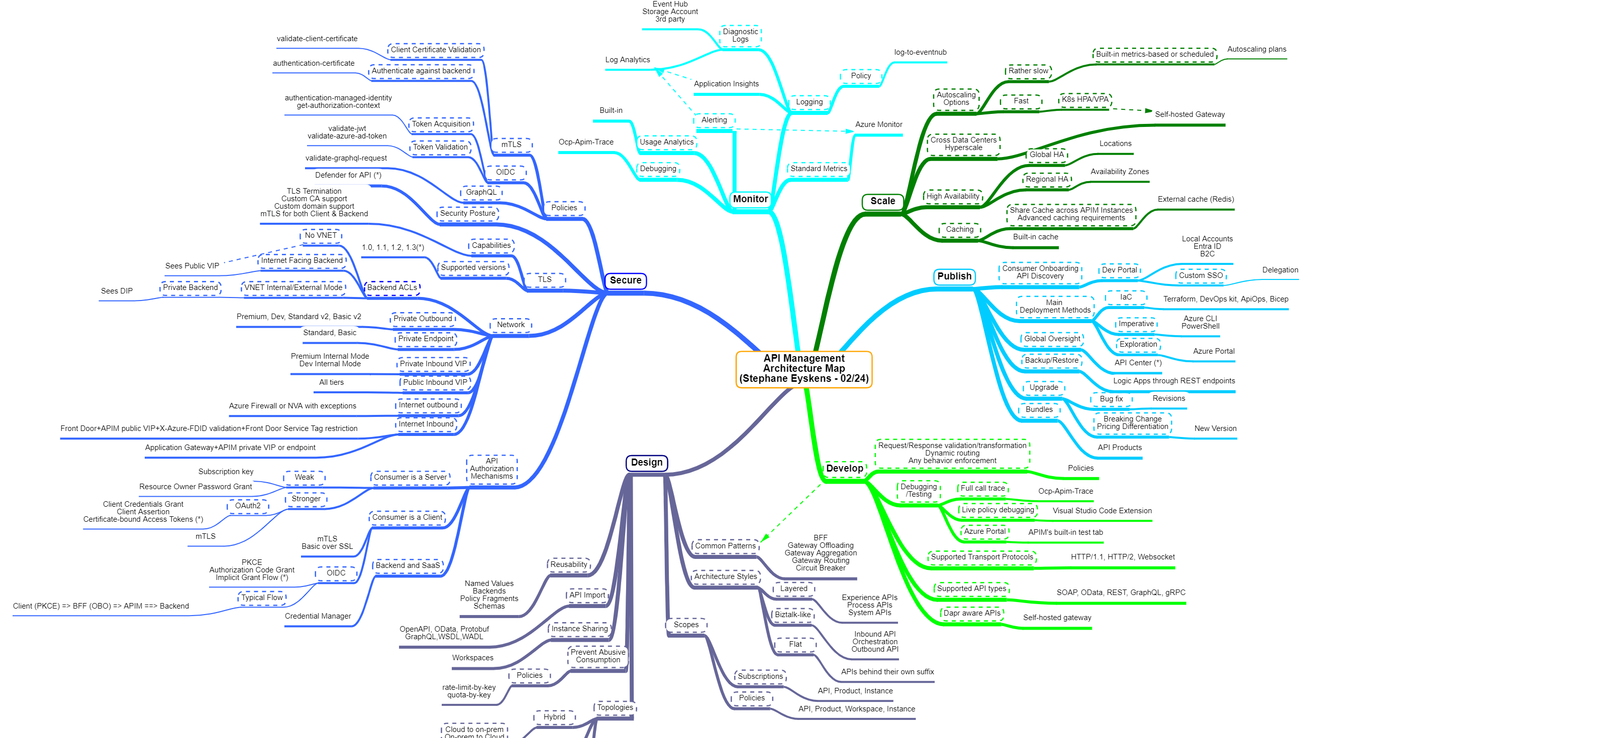
The API Management
Architecture Map
https://github.com/stephaneey/azure-and-k8s-architecture/blob/main/maps/apim.md

Slide 120
https://aka.ms/apimlove
Questions and discussions | http://aka.ms/apimso
Service updates, among other things | http://aka.ms/apimblog
GitHub repo with sample policies | http://aka.ms/apimpolicyexamples
Tutorial, documentation, and references | http://aka.ms/apidocs
Feedback and feature requests | http://aka.ms/apimwish
Roadmap | http://aka.ms/apimroadmap
Customer stories | http://aka.ms/apimcustomers

Slide 121
Architecting for Azure
1
2
3
Cloud Adoption Framework
Azure Architecture Center
Well-Architected Framework
Proven guidance and best practices that help you confidently adopt the cloud and achieve business outcomes.
Guidance for architecting solutions on Azure using established patterns and practices
A set of quality-driven tenets, architectural decision points, and review tools intended to help solution architects build a technical foundation for their workloads.
https://learn.microsoft.com/azure/cloud-adoption-framework//
https://learn.microsoft.com/azure/architecture/
https://learn.microsoft.com/azure/well-architected/

Slide 122


Slide 123


//garage
Do
Epic
Shit.

Slide 124
Importance in modern cloud architecture
Group 4
Group 1
Group 2

